Slide 1


SMART
Secure Management and Retrieval Technology
Team: Gurpreet K Hundal, Tiffany Valdecantos, Hellen Momoh, Spiro Habasch
Class: CSCI E-115 Advanced Practical Data Science
Term: Spring 2025

Slide 2




Problem Statement
Cost? Requirements?
Privacy?
Security?
Complex AI

Slide 3


Proposed Solution - SMART
Open Source Ollama Models
Secure
User Friendly
LLM

Slide 4

Live Demo

Slide 5



Technical Components Data Pipeline
VS Code
GCS Bucket
Validation
Postgres DB
Semantic
Chunking
Documents
Access.csv
Persistent Disk
Embedding
Meta.csv

Slide 6

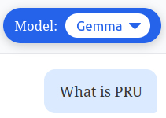






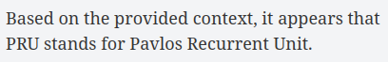

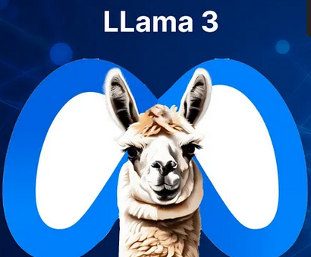
Technical Components
API
English
Frontend
Not English
Postgres DB

Slide 7



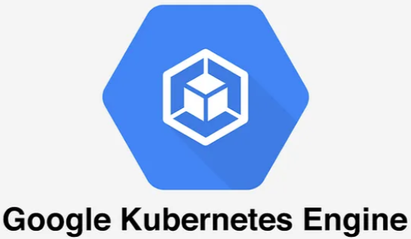

Technical Components Deployment

Slide 8
Challenge - No GPU in the GKE Cluster
Implemented Solutions
Ollama container
Async function & Timeout
Adjust resource limits

Slide 9

Thank you

